Slide 1
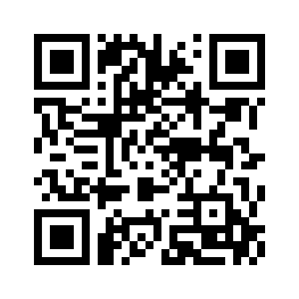

RMS Membership
Find out more
The Royal Microscopical Society is dedicated to the promotion and development of microscopy and imaging.
It is a vibrant society offering its members opportunities to network and to play an active part in the world of science. Our members come from a wide range of backgrounds, including undergraduates, research students, users of microscopy in industry and academia, microscopy manufacturers and suppliers, and research leaders in their various fields within the biological and physical sciences. They enjoy a range of benefits, not least being part of an international, multidisciplinary group of active microscopists.
Discounted registration fees for RMS meetings, courses and conferences
Access to an annual travel bursary
Access to summer studentship grant
Opportunities to contribute to outreach and public engagement events
Opportunities for CPD via the RMS Diploma
www.rms.org.uk. Registered Charity No. 241990

Slide 2
RMS Membership
Find out more
The Royal Microscopical Society is dedicated to the promotion and development of microscopy and imaging. It is a vibrant society offering its members opportunities to network and to play an active part in the world of science.
Benefits include:
Discounted registration fees for RMS meetings, courses and conferences
Access to an annual travel bursary
Access to summer studentship grant
Opportunities to contribute to outreach and public engagement events
Opportunities for CPD via the RMS Diploma
www.rms.org.uk. Registered Charity No. 241990

Slide 3
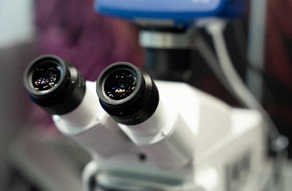
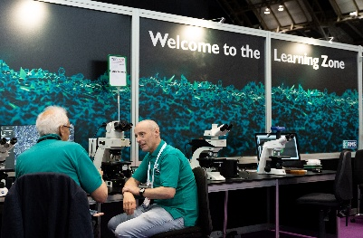
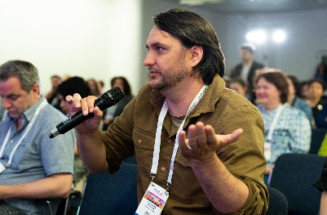
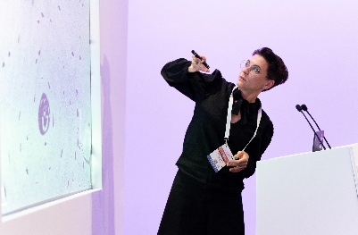
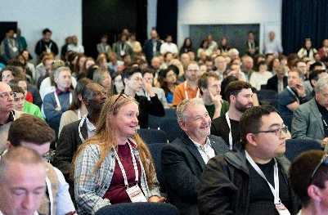
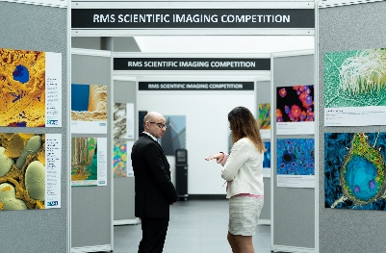
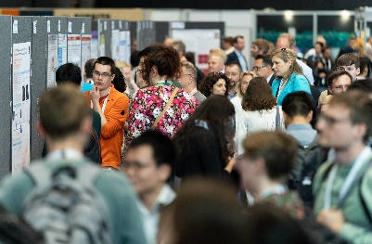
RMS Membership
Find out more
The Royal Microscopical Society is dedicated to the promotion and development of microscopy and imaging.
It is a vibrant society offering its members opportunities to network and to play an active part in the world of science. Our members come from a wide range of backgrounds, including undergraduates, research students, users of microscopy in industry and academia, microscopy manufacturers and suppliers, and research leaders in their various fields within the biological and physical sciences. They enjoy a range of benefits, not least being part of an international, multidisciplinary group of active microscopists.
www.rms.org.uk. Registered Charity No. 241990

