Slide 1





GloBIAS
Global BioImage Analysts’ society
a non-profit association for BioImage Analysts
Rocco D’Antuono
Crick Advanced Light Microscopy STP
The Francis Crick Institute, London (UK)
BioimagingUK Meeting, mmc, Manchester, 30 June 2025

Slide 2


GloBIAS - initiative
GloBIAS aims to pursue worldwide the activities promoting Bioimage analysis that were started by NEUBIAS - Network of European Bioimage Analysts
GloBIAS aims to provide the BioImage Analysts’ community with a sustainable base through a formal scientific society
Supported by a grant of the Chan Zuckerberg Initiative
  part of Advancing Imaging Through Collaborative Projects
  hosted by German BioImaging
  financed until December 2025

Slide 3
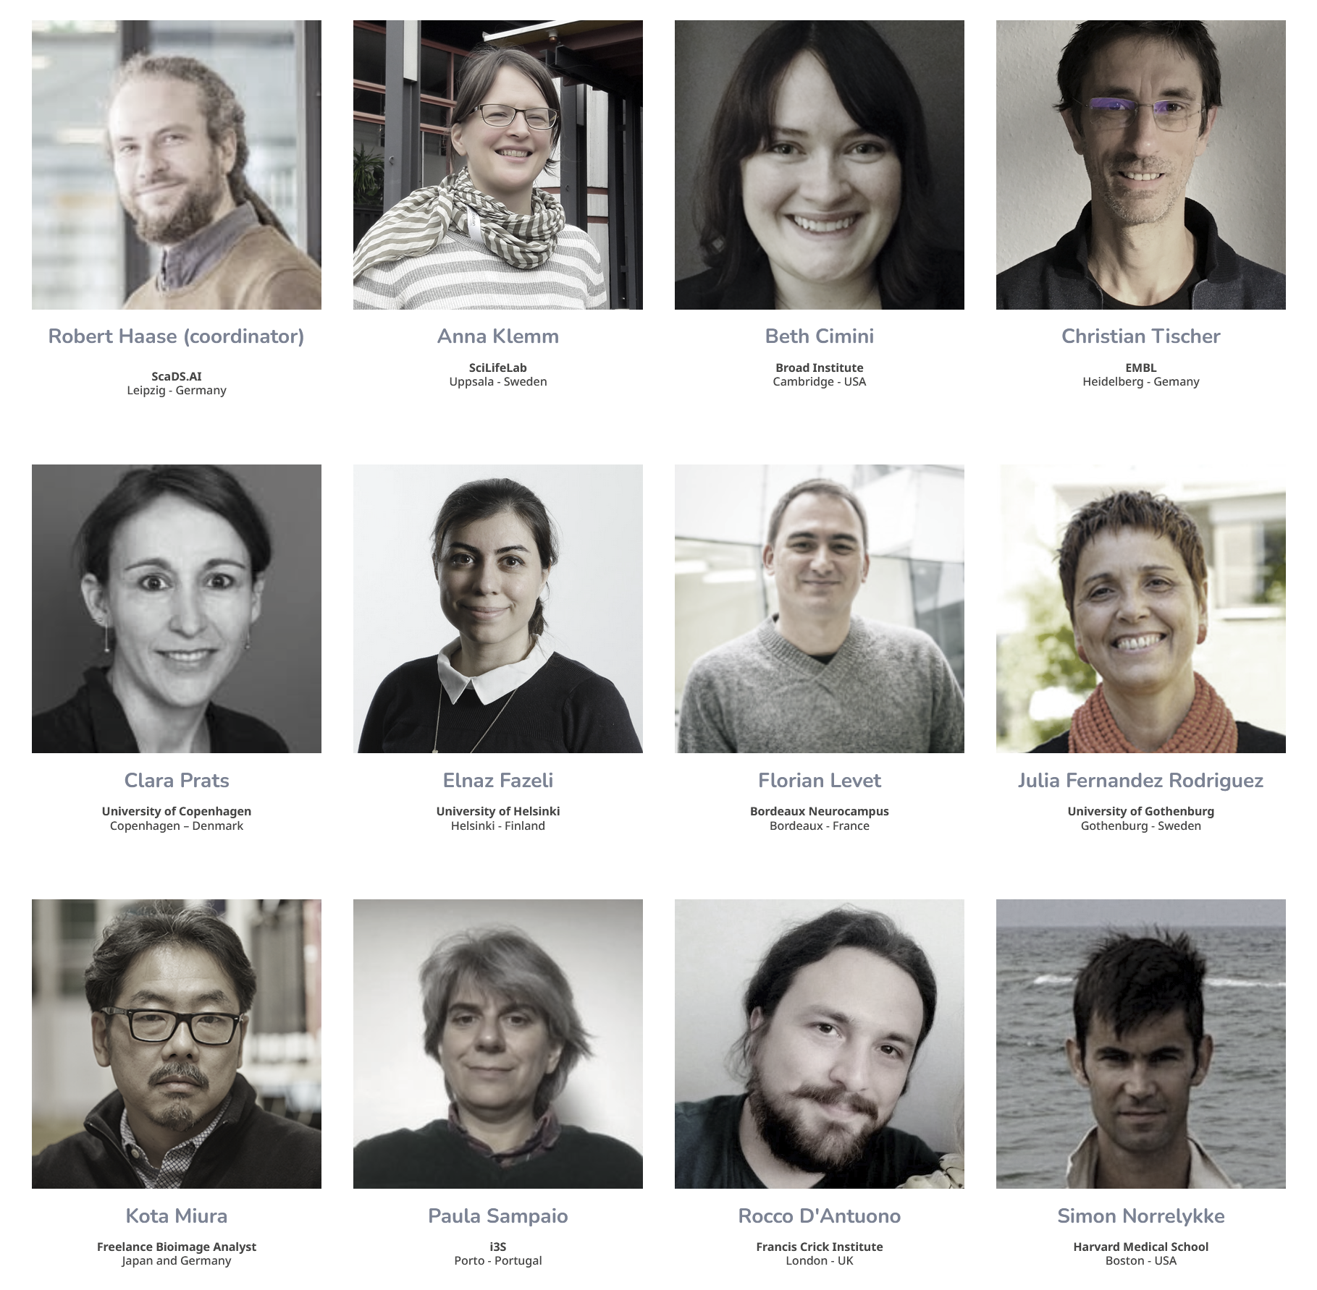
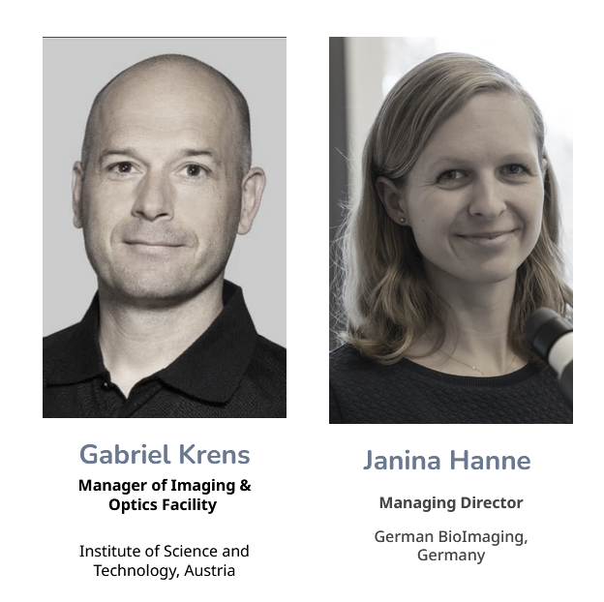
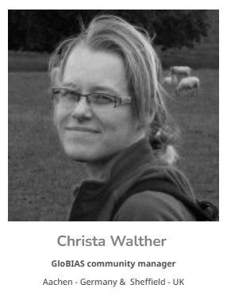
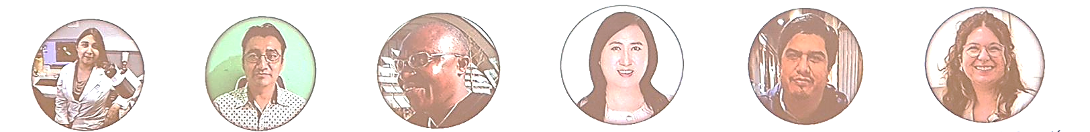
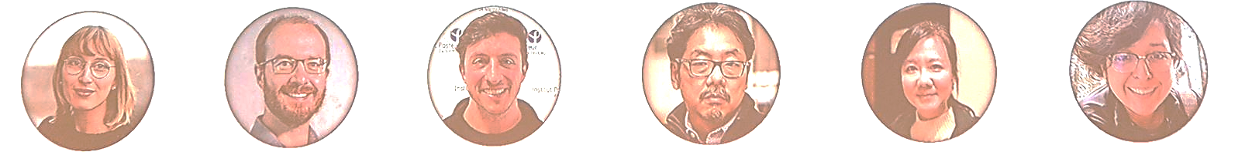
GloBIAS – contributors
Steering committee
SC advisors
Community Manager
GloBIAS Fellows (“Ambassadors”)
Nicole Salgado Cortes (Chile)
Paul Hernandez-Herrera (Mexico)
Libert Brice Tonfack (Cameron)
Wu Ya Jun (Singapore)
Cesar Valades Cruz (China)
Caterina Fuste-Barceló (Spain)
Melodie Ambroset (France)
Rensu Petrus Theart (South Africa)
Bruno Schuty Teske (Uruguay)
Kota Miura (Japan)
Shao-Chun Hsu (Taiwan)
Haydee Hernandez Avina (Mexico)
> 56 volunteers at workgroups

Slide 4
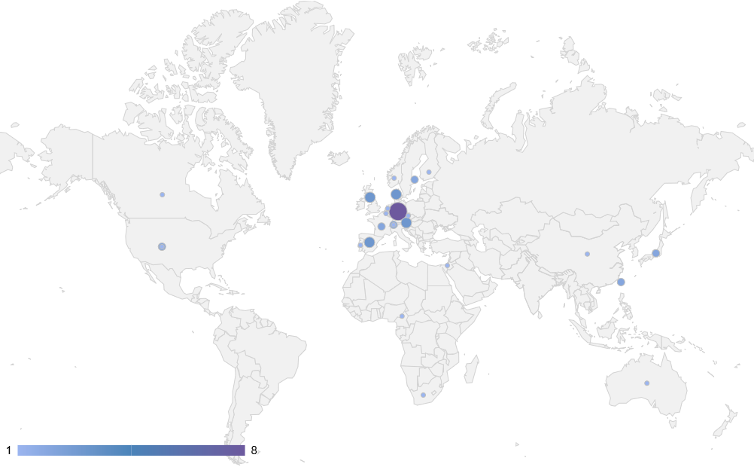
GloBIAS – Global BioImage Analysts‘ Society
Legal association to promote BioImage Analysis
  Verein zur Förderung der Bio-Image Analyse
  registered not-for-profit association (ZVR-Zahl 1485981412)
  registered in October in 2024 in Klosterneuburg, Austria
  self-sustained association with membership fees and community activities
The association aims to establish a scientific society to connect the global community of professionals working in or applying bioimage analysis
Membership is open to individuals and legal entities - already 42 members
  Ordinary member €100 (full) - €50 (students & *LIC)
  Extraordinary supporting members – €1000-5000
First General Assembly in June 2025
*LIC – Low-income country according World Bank

Slide 5
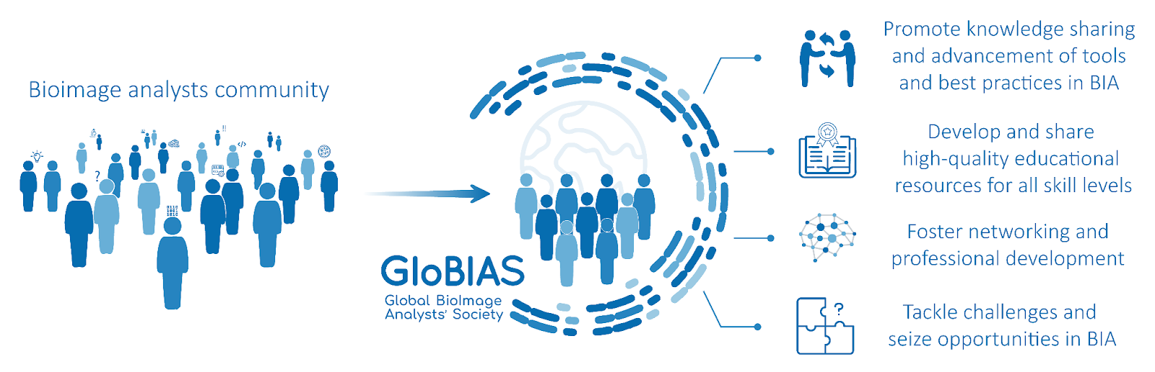
GloBIAS Society – Main missions
Advance Quantitative Bioimage Analysis
Enhance methods for measuring biological systems using image data.
Promote Collaboration & Standards
Foster knowledge exchange, tool development, and best practices.
Develop Comprehensive Educational Resources
Provide high-quality, accessible training for all skill levels.
Support Professional Development
Enable networking and career growth through events and initiatives.
Address Emerging Challenges in Bioimage Analysis
Respond proactively to new opportunities and issues in the field.
Establish Career Pathways for Bioimage Analysts
Advocate for formal recognition and structured career development.
Leverage Interdisciplinary Expertise
Embrace diverse backgrounds while addressing related challenges.
Corbat, Walther, Rodriguez de la Ballina, et al, manuscript under submission

Slide 6
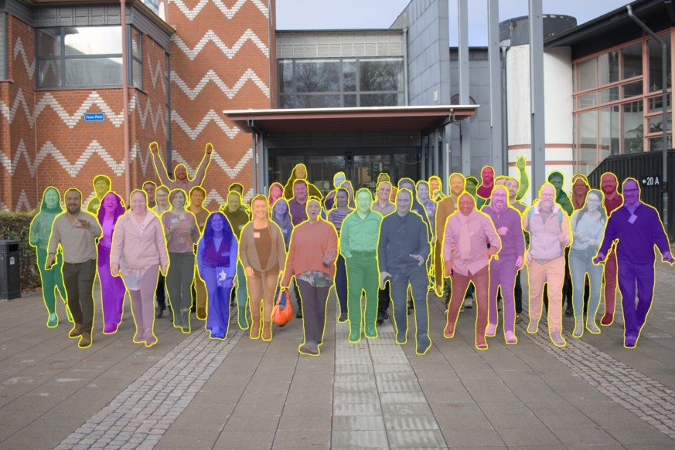
GloBIAS – workgroups
Teaching and Education
  leads: Christian Tischer (EMBL, Heidelberg, Germany), Beth Cimini (Broad Institute, Cambridge, USA)
Communication
  lead: Paula Sampaio (i3S, Porto, Portugal)
Survey 2024
  lead: Robert Haase (Scads.AI, Leipzig), Agustin Corbat (SciLife Lab, Upsala)
Society Implementation group
  lead: Christa Walther (German BioImaging, Aachen/Sheffield)
Workshop 2024 (closed)
  leads: Julia Fernandez-Rodriguez (University of Gothenburg, Sweden), Christa Walther (GloBIAS)
BIA Conference 2025
  lead: Kota Miura (freelance, Japan)
Publications
  leads: Kota Miura (freelance, Japan), Rocco D’Antuono (Francis Crick Institute)
HPC and cloud computing for image analysis
  lead: Tatiana Woller (KU Leuven, Belgium), Nicholas Condon (University of Queensland, Australia)
1st GloBIAS in-person workshop in Sweden

Slide 7
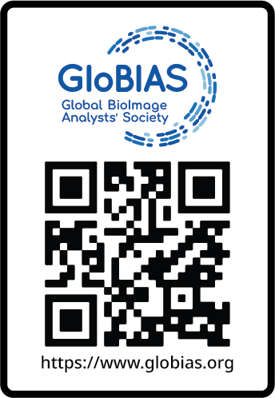
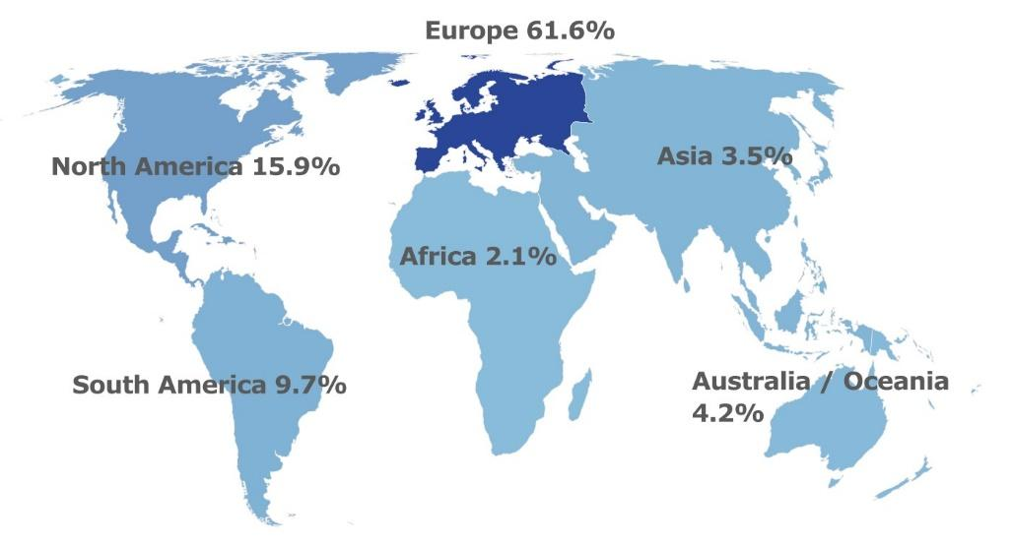








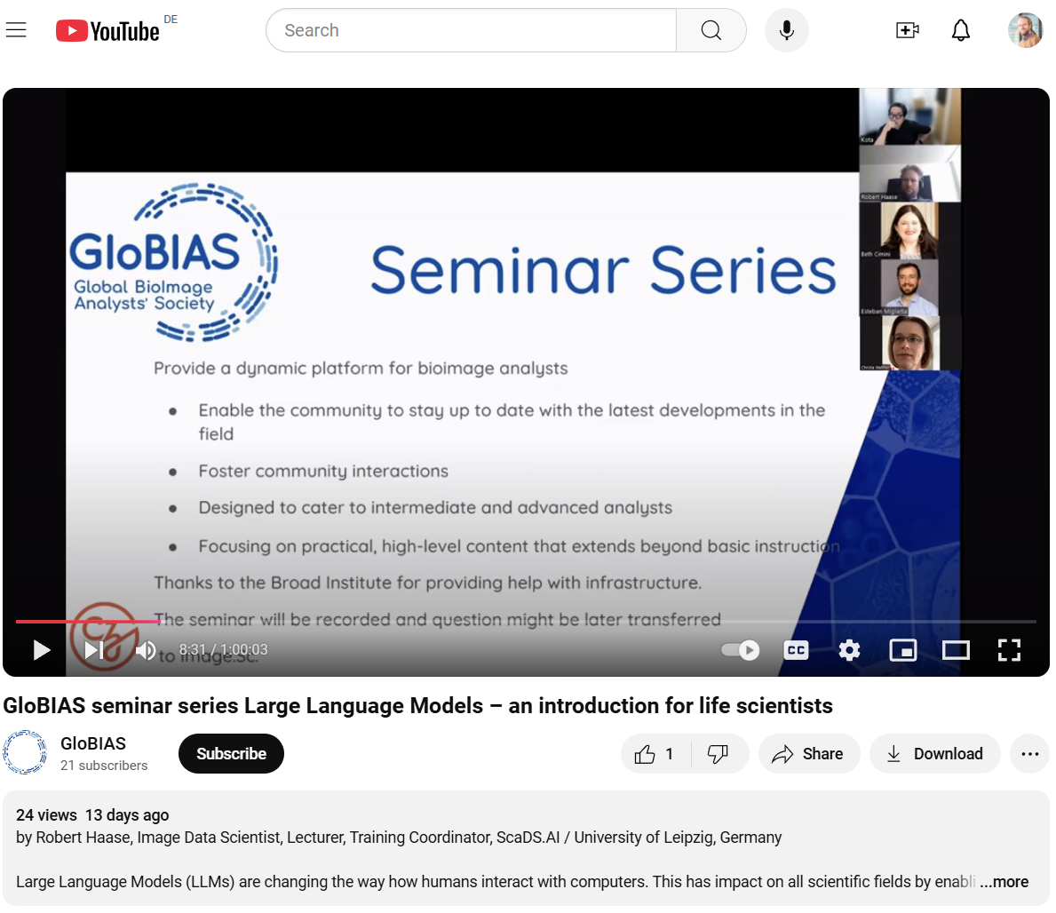
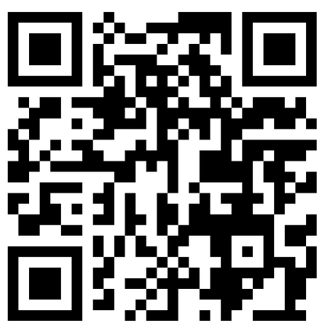
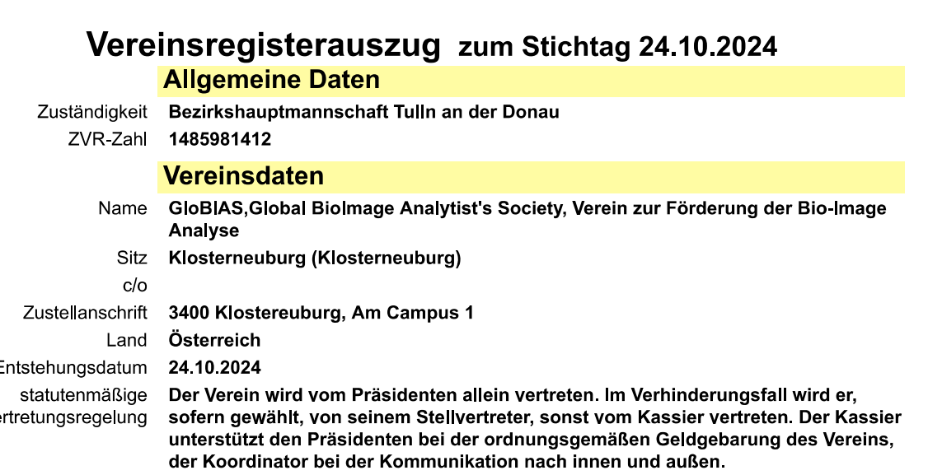
GloBIAS – achievements
Community Needs Survey
Identity and Website
https://www.globias.org
Survey of BioImage Analysts worldwide
publication in progress
Interaction with international networks
e.g. BINA, UK BioImaging, Labi, ABIC, Euro-Bioimaging…
Workshop and Conference (2024 and 2025)
November 2024 (Sweden) and October 2025 (Japan)
Regular online and in-person events
workgroup meetings, monthly webinars, GloBIAS Free Help sessions
YouTube channel
31 videos, https://www.youtube.com/@globias
Publication of materials
webinars have follow-up in Image.sc, Zenodo report of workshop, blog series,
bi-monthly newsletter, data carpentries – updated curriculum,…
Found a not-for-profit association for BioImage Analysts’
registered Oct 2024, Austria

Slide 8
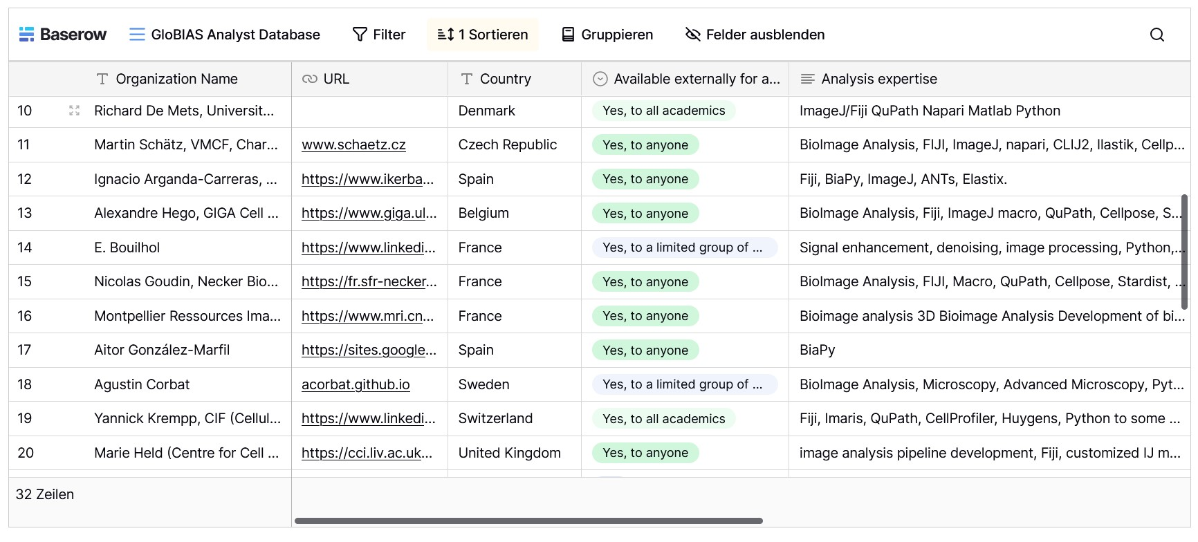
GloBIAS – achievements
Identity and Website
https://www.globias.org
GloBIAS maintains databases (links below) of people who wish to be publicly listed as bioimage analysts or as bioimage analysis trainer in our global registry.
Registration form via link on the webpages: https://www.globias.org/resources/database-registry-form.

Slide 9
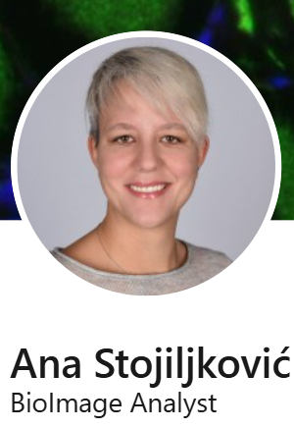
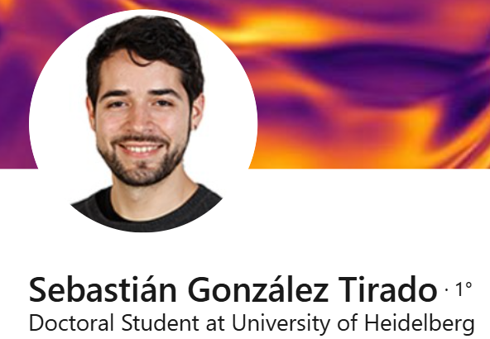
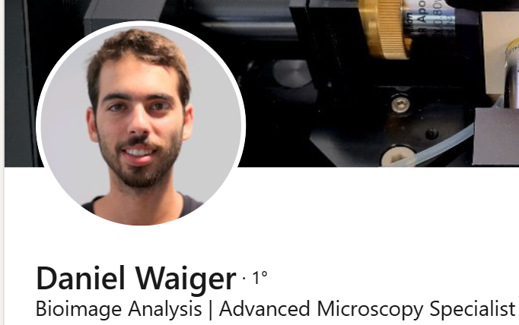
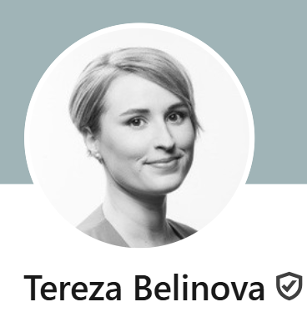
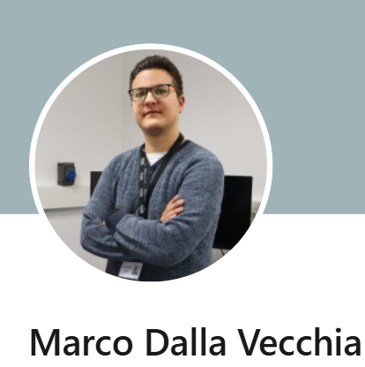
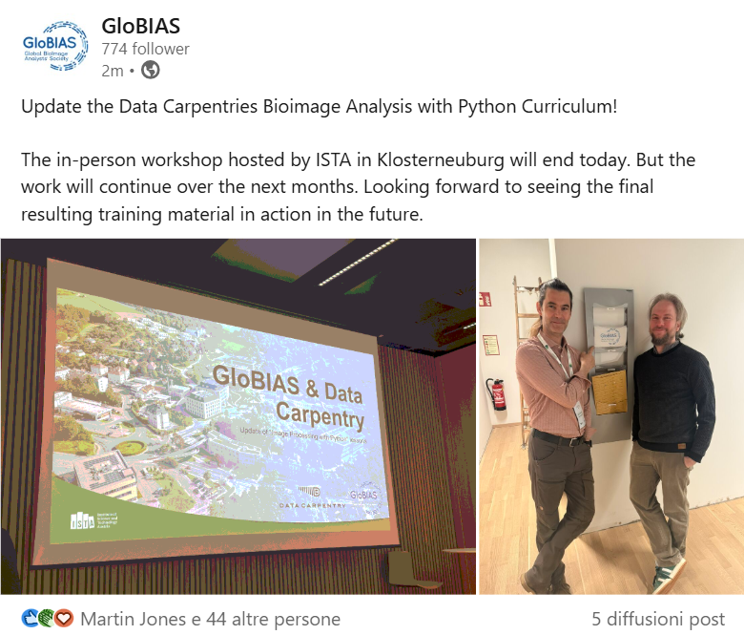
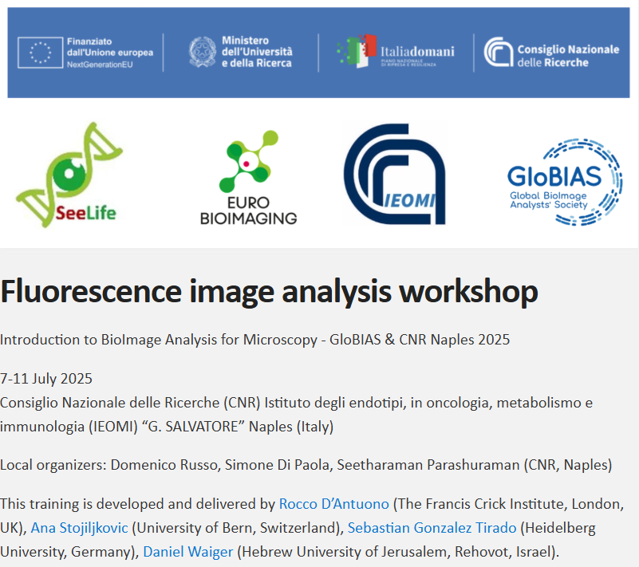
GloBIAS – achievements
Regular online and in-person events
workgroup meetings, monthly seminars, bi-monthly webinar, GloBIAS Free Help sessions
update the Data Carpentry
model Training Schools
https://globias-bioimageanalysts.github.io/Fluorescence_image_analysis_workshop-GloBIAS_CNR_Naples_2025/
https://github.com/GloBIAS-BioimageAnalysts/2025-04-07-GloBIASDataCarpentry-Workshop

Slide 10
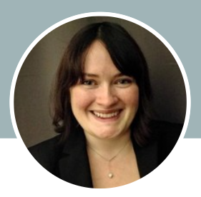
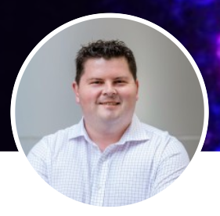
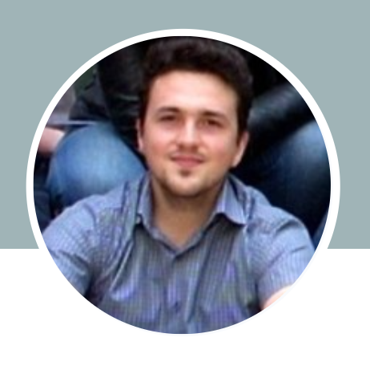

GloBIAS - activities on the horizon
Special Issue of
Journal of Microscopy
previous DAIM
special issue
Beth Cimini
Broad Institute, USA
Nicholas Condon
University of Melbourne, AU
Rocco D’Antuono
Francis Crick Institute, UK
“High-Performance Computing and
cloud- based solutions for bioimage analysis”
collaboration between
GloBIAS HPC working group and DAIM-RMS
https://doi.org/10.1111/jmi.13366

Slide 11
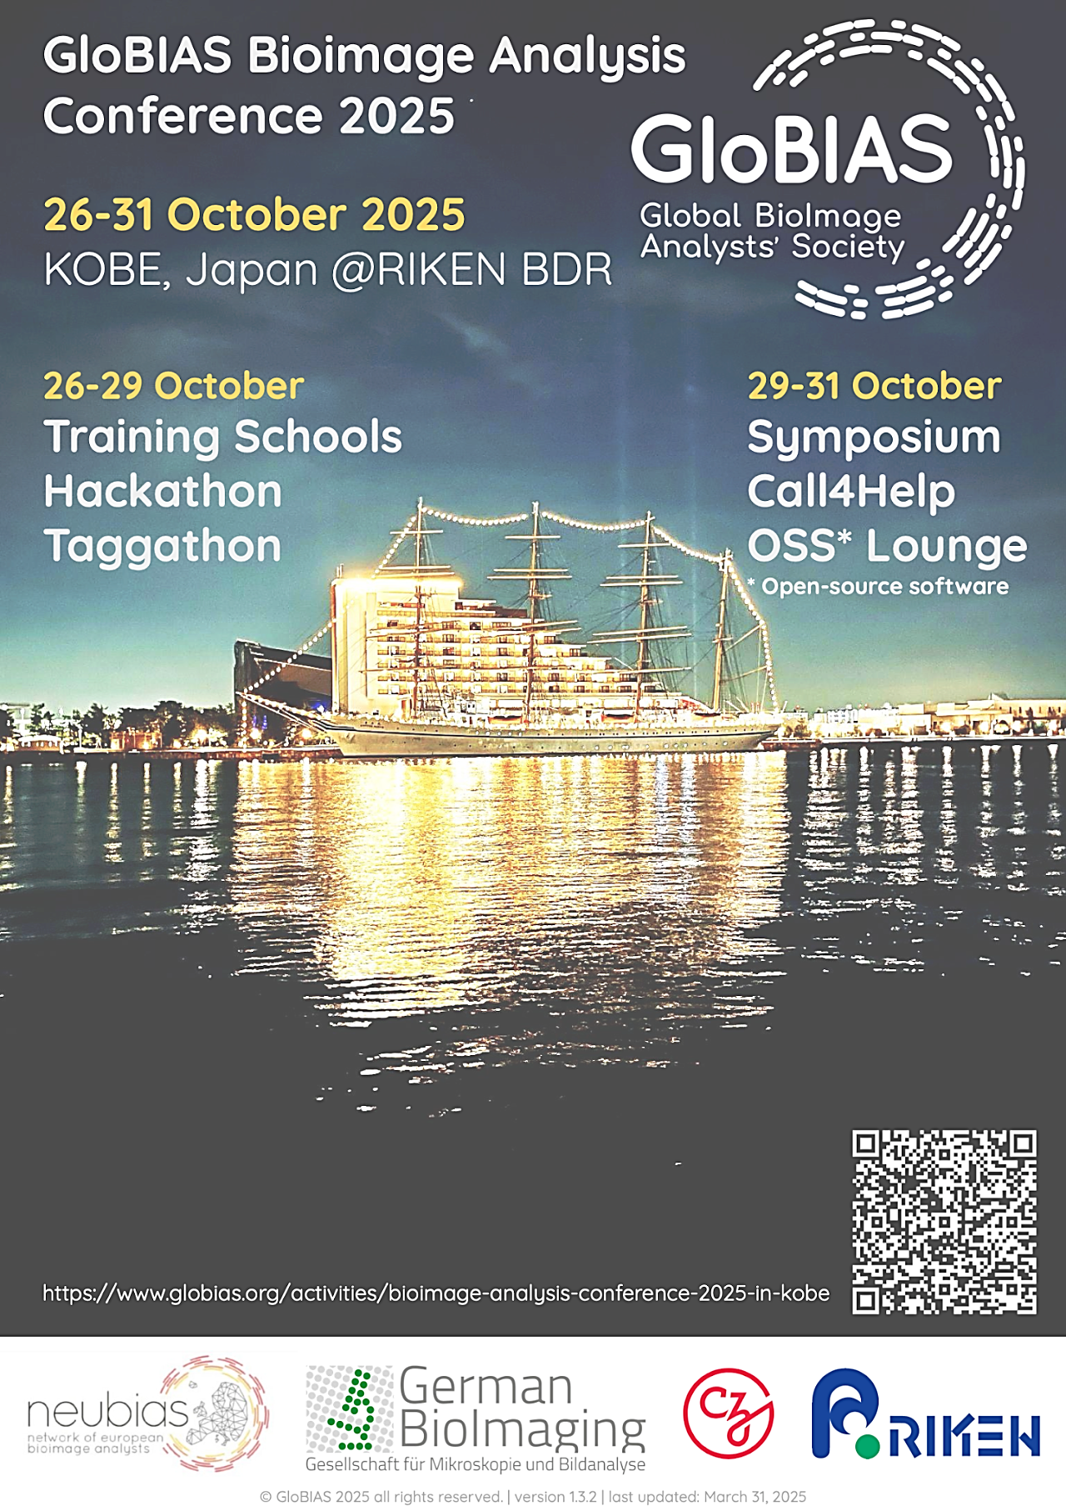
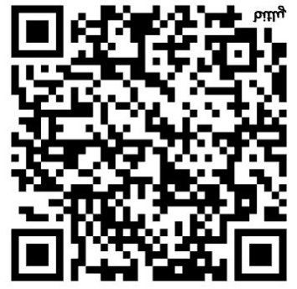
GloBIAS - activities on the horizon
BioImage Analysis Conference 2025
26 – 31 October 2025 Kobe, Japan
Training School
  structured learning opportunities for novices and experienced analysts could enhance their skills and stay current with evolving techniques
Hackathon
  teams work to create new analytical tools that solve emerging challenges in the field
Taggathon
  organizing and cataloguing existing tools, making the growing ecosystem of bioimage analysis resources more accessible and usable for the community
Symposium
  presentations from invited experts
  panel discussions
  open-source software lounge (OSSL)
  call-4-help session
Registration deadline – 15 September 2025
Notes:
The conference strategically combines multiple elements to address different facets of bioimage analysis advancement. During the initial days, participants engage in parallel sessions that serve distinct but complementary purposes. The training school component offers structured learning opportunities where novices and experienced analysts alike can enhance their skills and stay current with evolving techniques. The hackathon fosters innovation through intensive collaborative development, where teams work together to create new analytical tools that solve emerging challenges in the field. The taggathon activities focus on the essential task of organizing and cataloguing existing tools, making the growing ecosystem of bioimage analysis resources more accessible and usable for the broader scientific community.
As the conference progresses to its second half, the focus shifts to a symposium designed for broader knowledge dissemination. This portion features presentations from invited experts who share cutting-edge advancements and methodological breakthroughs. The intellectual exchange continues through poster sessions, where attendees present their research findings and receive valuable feedback. Panel discussions create spaces for deeper exploration of complex topics and emerging trends, allowing for nuanced debate among diverse perspectives. The open source software lounge (OSSL) provides a unique opportunity for direct interaction between users and developers, fostering collaboration and immediate problem-solving. The call-4-help session, where participants can present specific analytical challenges they face, and the collective expertise of the community converges to develop impromptu solutions.

Slide 12




GloBIAS - Want to know more?
check GloBIAS website
register as member of society
sign up to bi-monthly newsletter
follow us on social media:
    LinkedIn – GloBIAS
    X - @GloBIAS_
    Bluesky - globias.bsky.social
    YouTube - @globias
Join GloBIAS!
Everyone interested in BioImage Analysis is welcome
Please contact us at info@globias.org

Slide 13


GloBIAS Society – Ordinary members
For individuals
  E.g. bioimage analysts, software developers, life scientists, biologists, physicists, bioinformaticians,
  research software engineers, microscopists, …..
Benefits
  Integration into an active community focus on Bioimage Analysis that influence the development of the field
  access to specific reviewed information and training materials
  regular online events such as seminars and webinars and in-person events (workshop, symposia and hackathons)
  discounted access to events and training programs organised and offered by the association
  regular newsletter with updates on the society
  advertise open positions/jobs for BioImage Analysts on the GloBIAS website
  become part of Focus Groups within the society, dedicated to collaborating on and discussing specific topics of interest
  opportunities to become involved in training sessions and ‘Call for help sessions’ on the advising side
Annual membership fee per calendar year
  Ordinary member - €100
  MSc and PhD students - €50
  People based in low low-income economy countries benefit of a 50% discount on the above fees.

Slide 14
GloBIAS Society – Extraordinary supporting members
For Associations, Organisations and Societies and other legal entities
  e.g. companies, universities, scientific institutes
Benefits
  Publicly acknowledged on the GloBIAS website as an Extraordinary Supporting Member.
  Participate in thematic focus groups and contribute to field development through dialogue and collaboration.
  May nominate one representative to the GloBIAS Scientific Advisory Committee (if established).
  Entitled to a single vote in the General Assembly, same as ordinary members.
  Receive timely updates via the GloBIAS member newsletter.
  Enjoy preferential conditions for events and workshops, within legal limits for non-profit associations.
Annual membership fee per calendar year
  Small (less than 10 workers) €1,000
  Medium (11–50 workers) €2,500
  Large (51–250 workers) €4,000
  Big (more than 250 workers) €5,000
  Annual membership fees are used exclusively to support the non-profit purposes of the association
  Voluntary donations are also highly appreciated

Slide 15
GloBIAS Society – main vision and goals
Corbat, Walther, Rodriguez de la Ballina, et al, manuscript under submission

