Slide 1
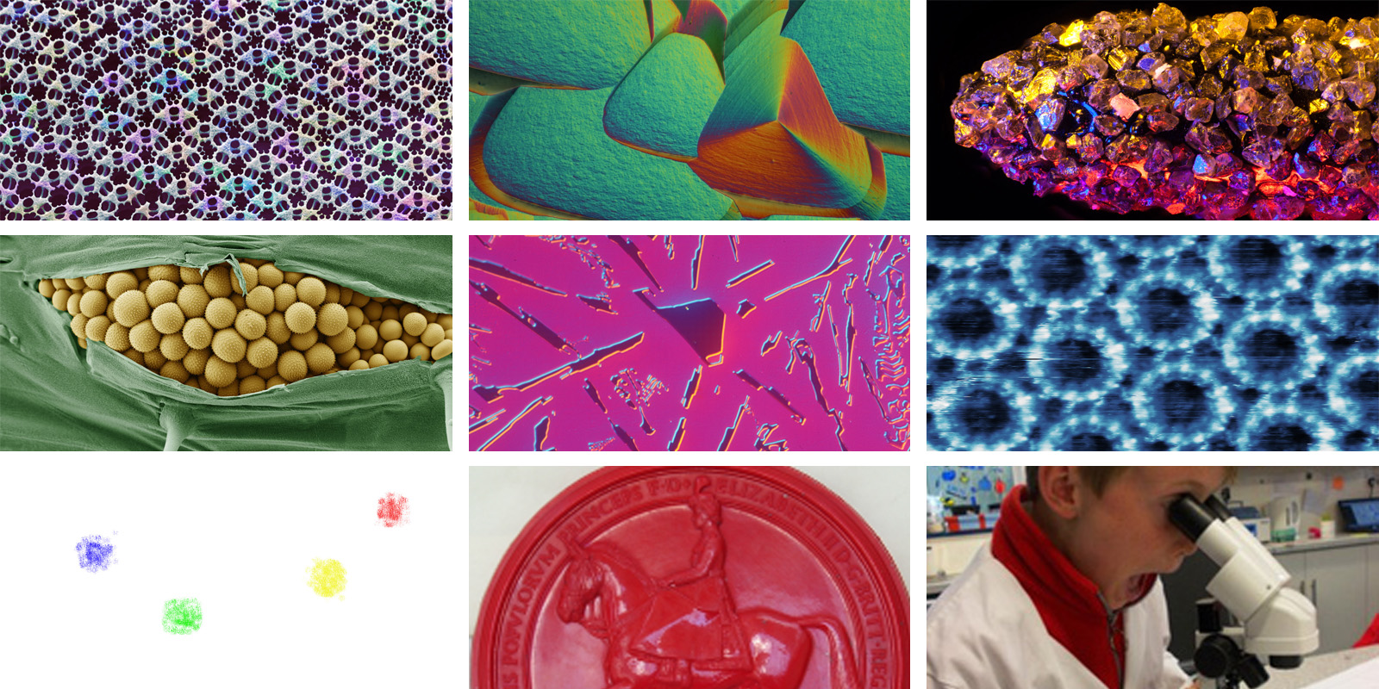

The Royal Microscopical Society
at the forefront of microscopy since 1839

Slide 2
Science Sections
Electron Microscopy
Light Microscopy
Flow Cytometry
AFM and Scanning Probe Microscopies
Engineering, Physical & Material Sciences
Life Sciences
Data Analysis in Imaging
Early Career Committee
Outreach and Education
History

Slide 3
Focussed Interest Groups
Mass Spectrometry Imaging
Professional Development & Training
X-ray Microscopy
Ion Beam Microscopy

Slide 4


The oldest journal dedicated to the science of microscopy and the only peer-reviewed publication of the Royal Microscopical Society.
Publishes papers that report on the very latest developments in microscopy, such as advances in microscopy techniques or novel areas of application.
Publication types include full papers, hot topic fast-tracked communications and review articles.

Slide 5
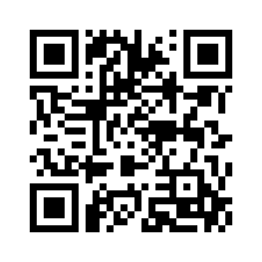
Membership Benefits
Discounted registration fees for RMS meetings, courses and conferences
Access to an annual travel bursary
Access to summer studentship grant
Opportunities to contribute to outreach and public engagement events and funding support for your microscope-related outreach events.
Opportunities for CPD via the RMS Diploma

Slide 6
Recently started working in microscopy?
First year free RMS membership for undergraduate students
Reduce membership registration for Doctoral and Early Career membership
Join for early career advice, conference discounts and more!
Look out for sessions at mmc2025 aimed at students, postdocs, and early-career professionals
Follow the Early Career Committee on X @RMS_EarlyCareer

Slide 7
RMS Travel Bursaries for Members
If you are an early career researcher, normally within 12 years of starting your PhD, or are employed in a support role in microscopy or cytometry, then these are for you.
www.rms.org.uk/opportunities/bursaries

Slide 8
Summer Studentships
Each year £2,000 available for six student projects with significant microscopy element
Successful projects chosen with even balance across physical, biological and interdisciplinary sciences.
Students completed project reports published in infocus Magazine
www.rms.org.uk/opportunities/summer-studentships

Slide 9
Professional Internship Placements
We have been pleased to host five Professional Internship Placement students in recent years, providing an opportunity for the students to develop their skills in a new environment.
Through this scheme, the Society gains fresh perspectives and ideas, and it results in great projects that benefit both the Society and the community.
www.rms.org.uk/opportunities/professional-internship-placements

Slide 10
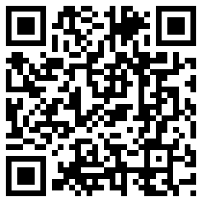
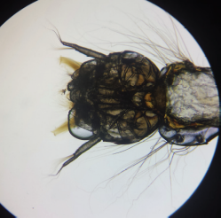
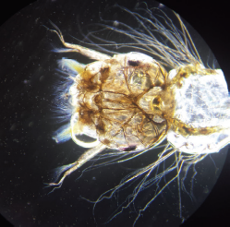
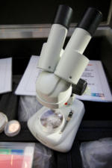
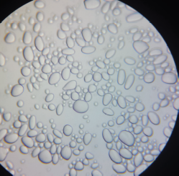
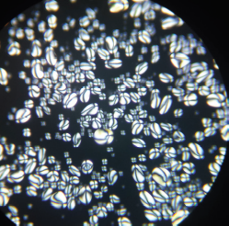
Microscope Activity Kits
Free Microscope Activity Kits for primary schools - helped over 100,000 schoolchildren

Slide 11
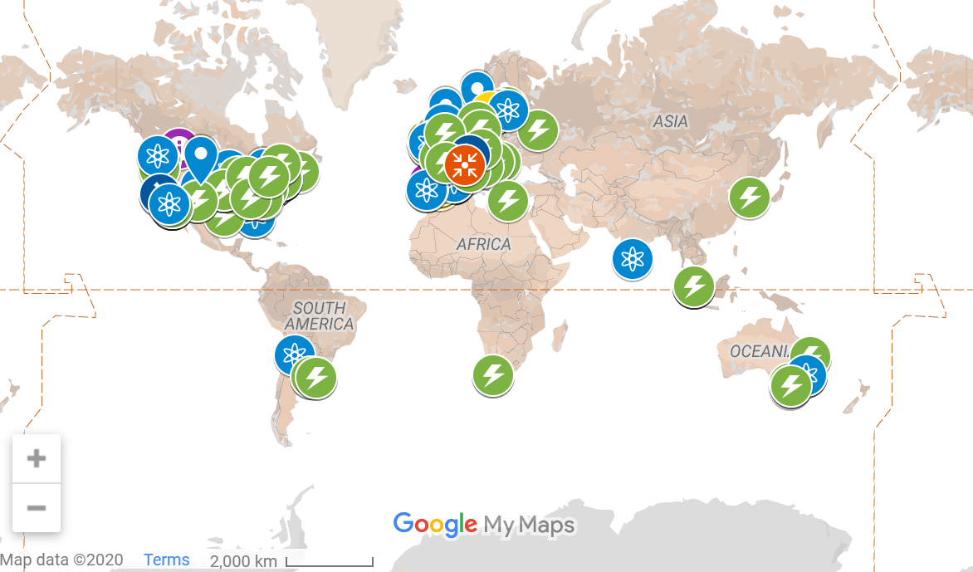
Supporting Equity in Microscopy
In collaboration with Sian Culley at University College London
www.rms.org.uk/community/
equity-microscopy-resource

Slide 12
RMS Diploma
We are committed to encouraging our members to improve and develop their skills. We believe qualifications play an important part in this.
These are challenging and rewarding whilst fitting around, and complementing, the candidate's existing employment.
www.rms.org.uk/opportunities/rms-diploma

Slide 13
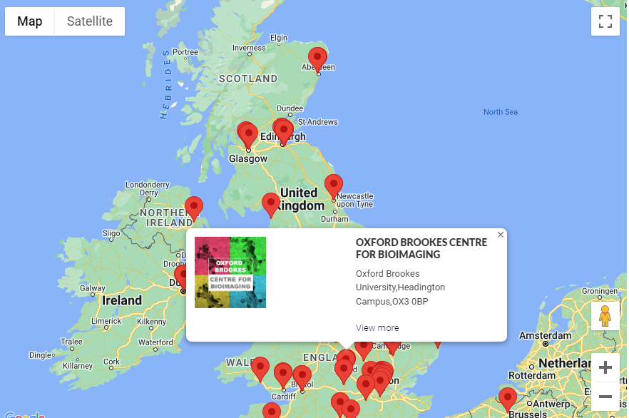
RMS Facility Database
Use the RMS Facility Database to search for Facilities across the globe
www.rms.org.uk/community/
facilities-database.html

Slide 14

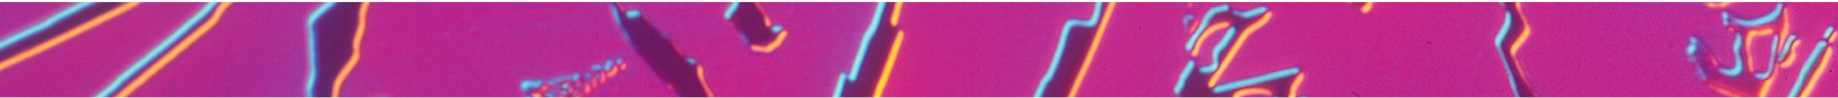

1 - 3 July 2025, Manchester, UK
Plenary Speakers | Invited & Submitted Talks | Poster Sessions | Huge Exhibition | Commercial Workshops | Learning Zone | Satellite Meetings | Scientific Imaging Competition | Great Networking Programme

Slide 15

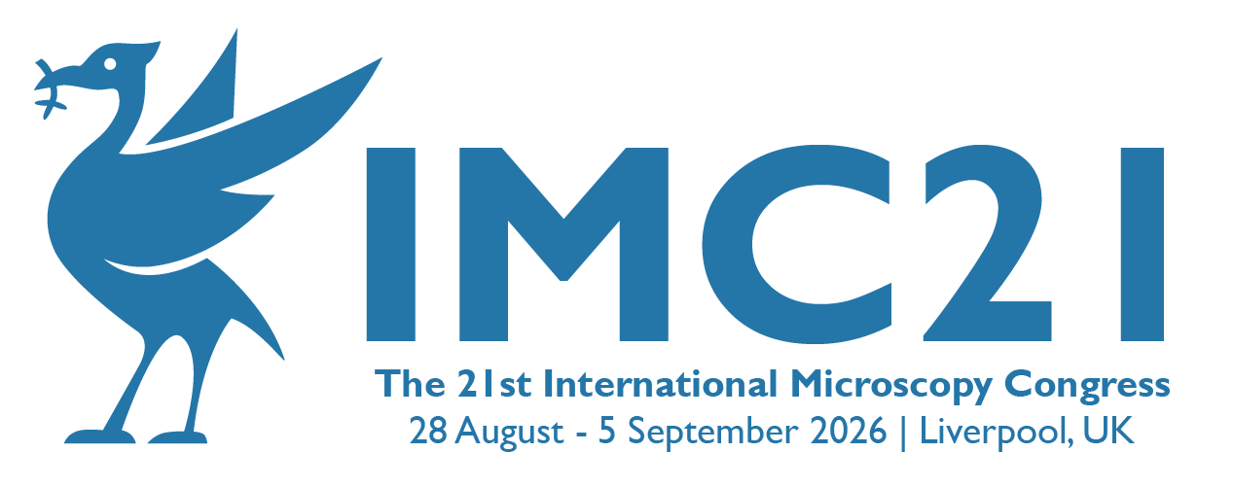
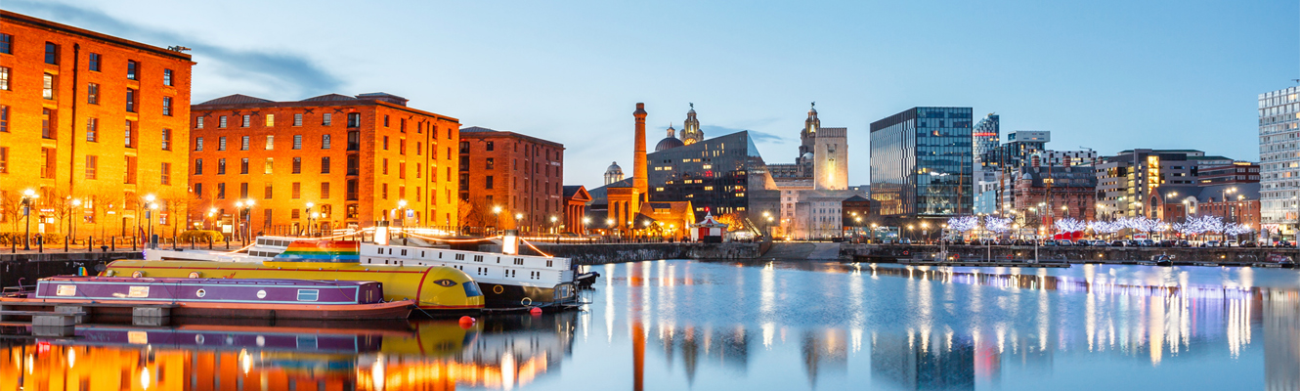

Slide 16
The Royal Microscopical Society
at the forefront of microscopy since 1839

