Slide 1


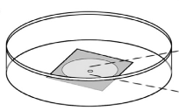
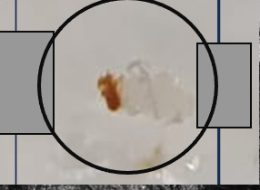
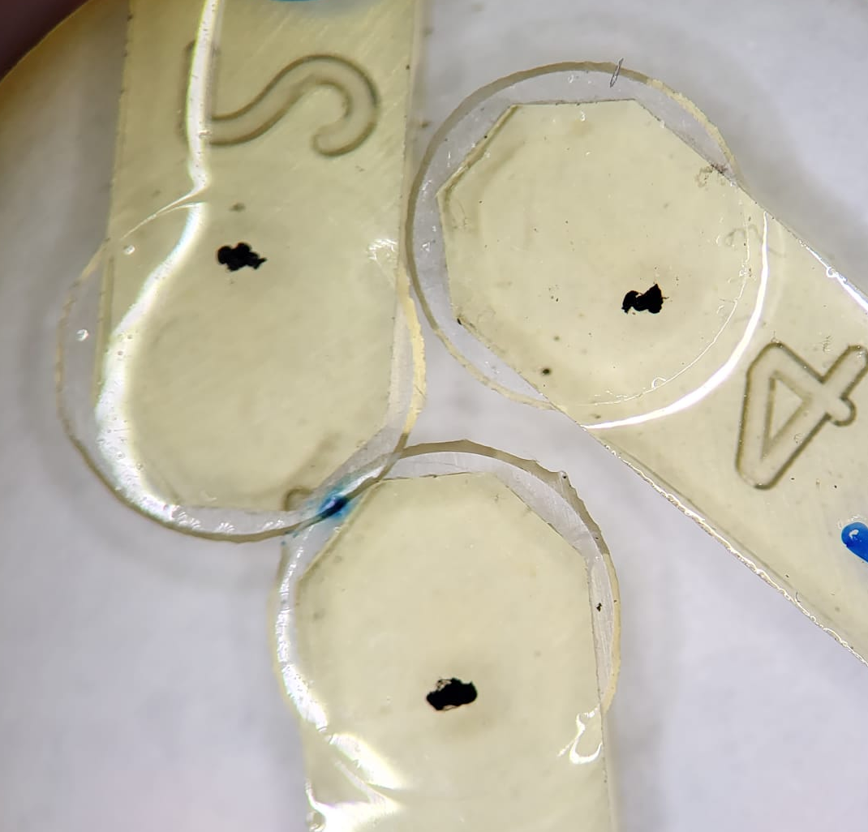
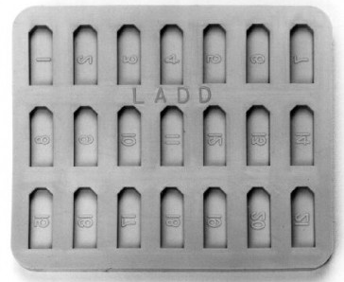
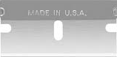
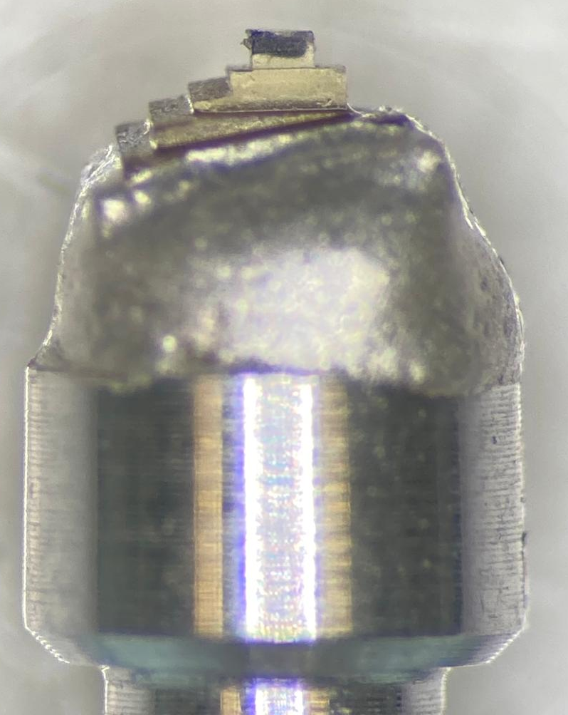
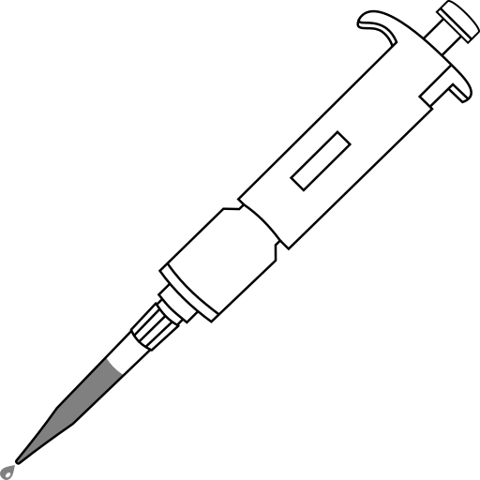

CLEM Prep for drosophila brain
A
D
Using a glass bottom imaging dish A, put spacers made from sticky tape onto the c/s B. Dissect fly brain and place between tape. place a 6mm PLL coated coverslip gently on top of brain for stability C
F
B
B
F After polymerization, Pop C/S off with the help of LN2
Image brain D
C
G
F
Gently pipette fixative under c/s E. After fixation use a razor blade to gently lift c/s from tape F. Brain should stay attached to c/s. Flip c/s over and continue with staining/dehydration
H
Fill mould G, to top. with resin and place c/s on brain side down
Cut brain out, attach to pin in desired orientation H
E
www.liverpool.ac.uk/emunit/

