Slide 1
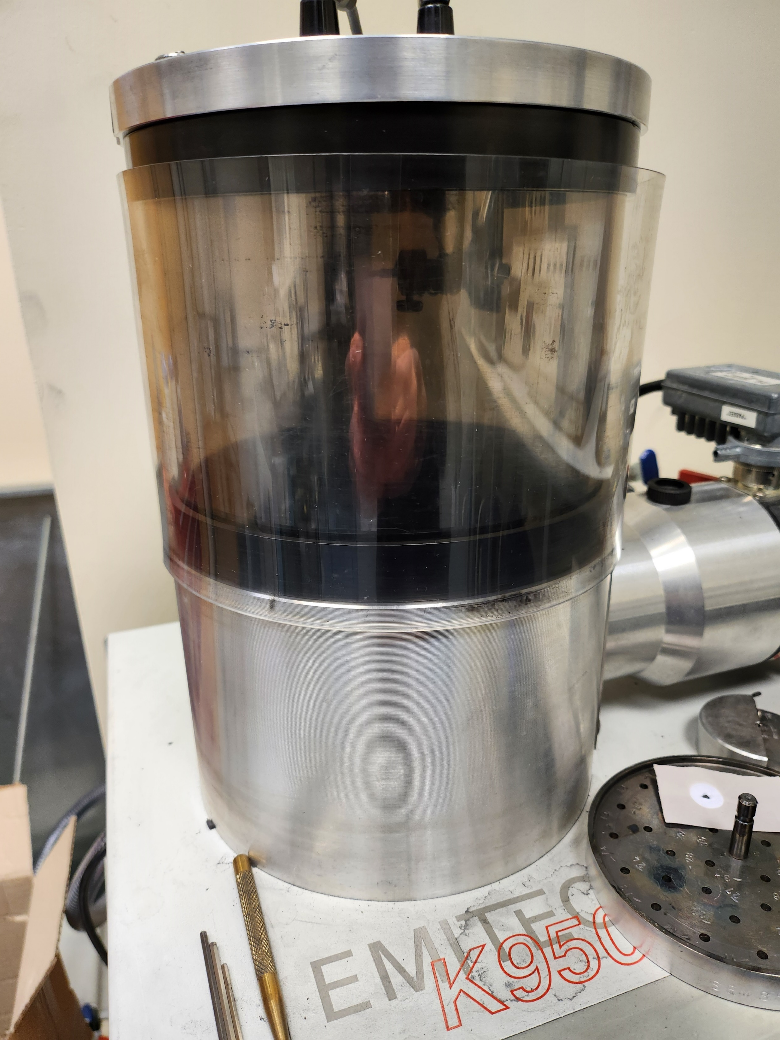
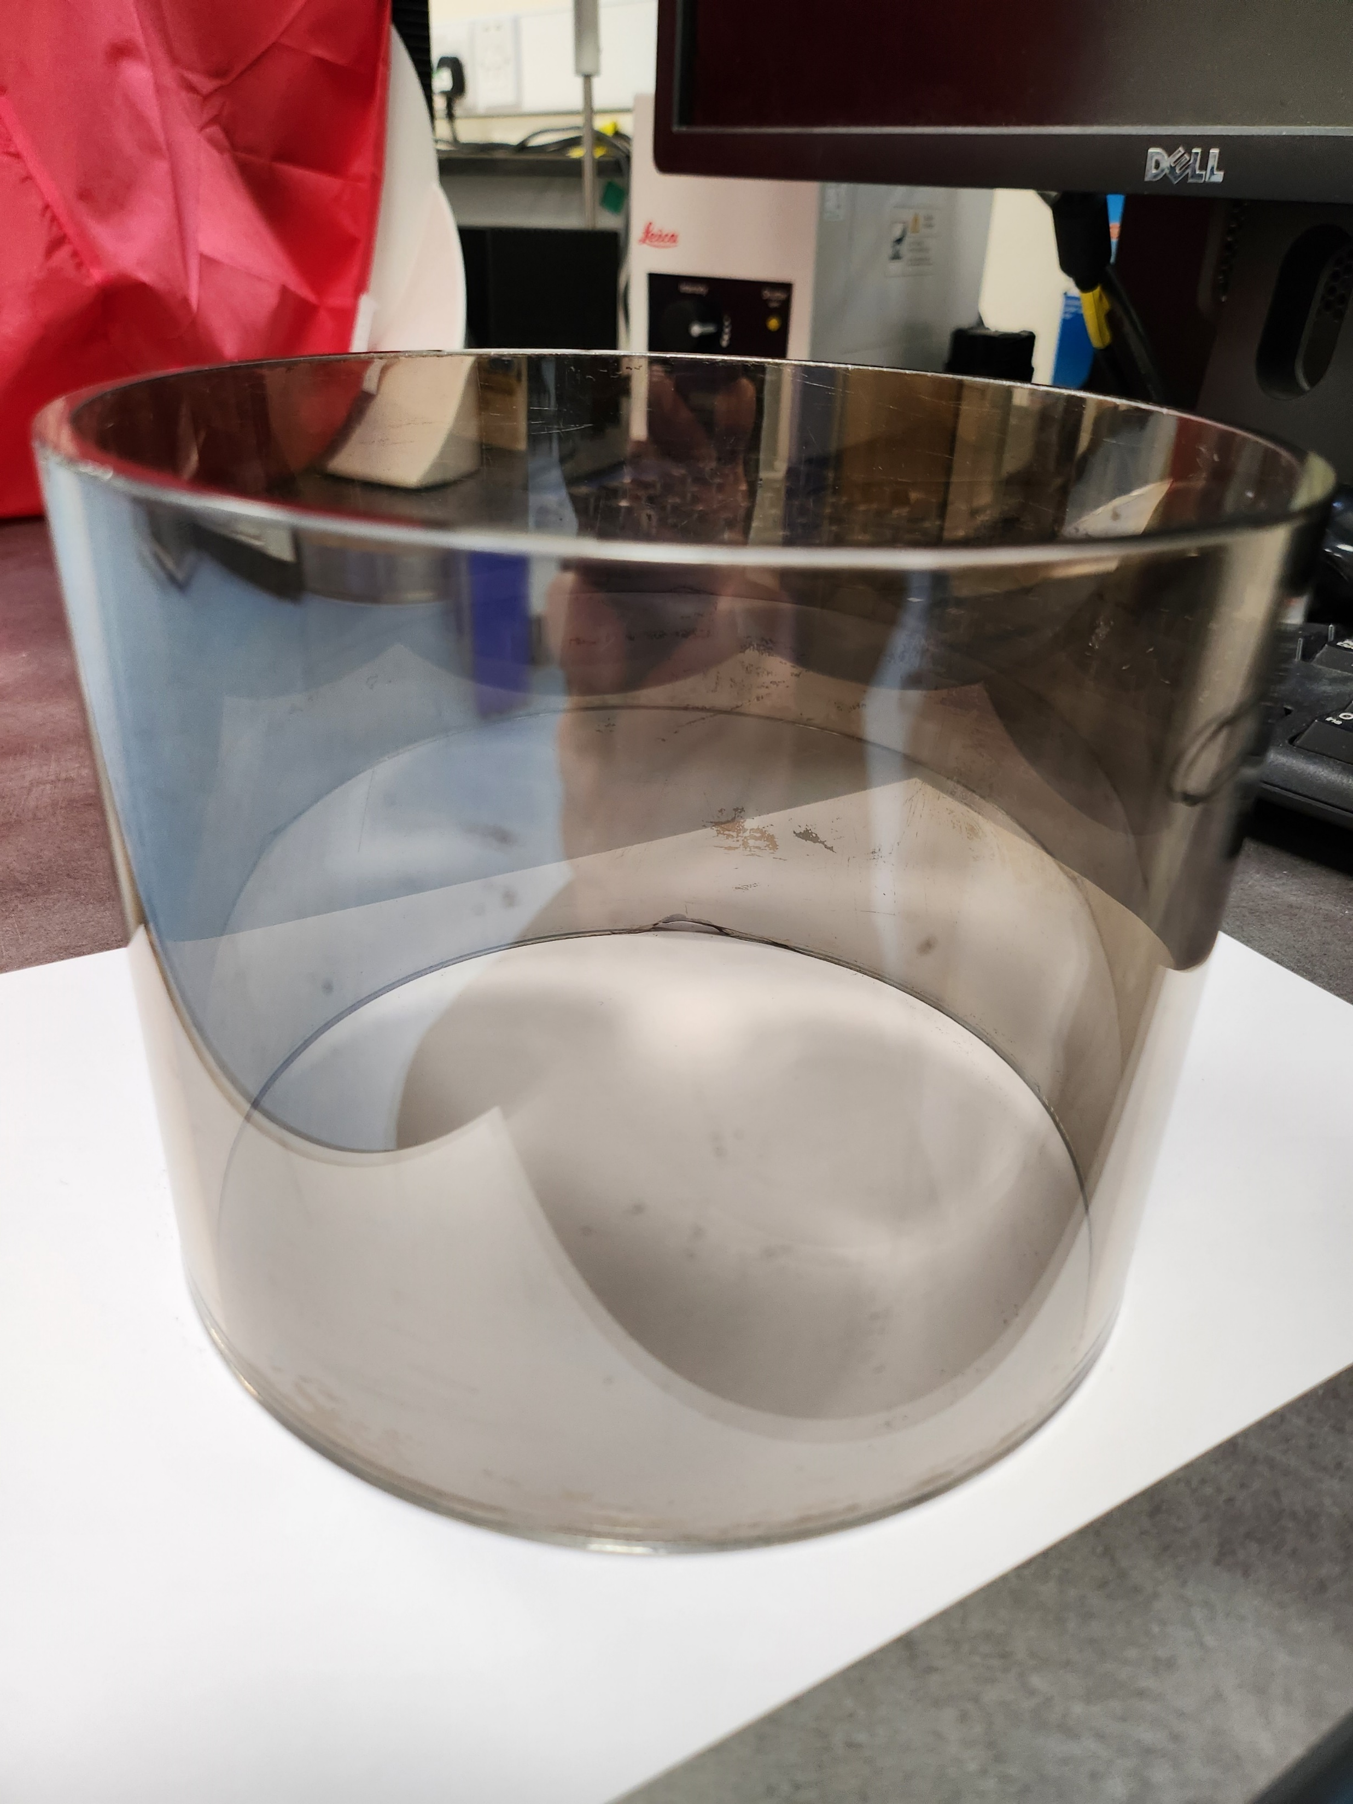
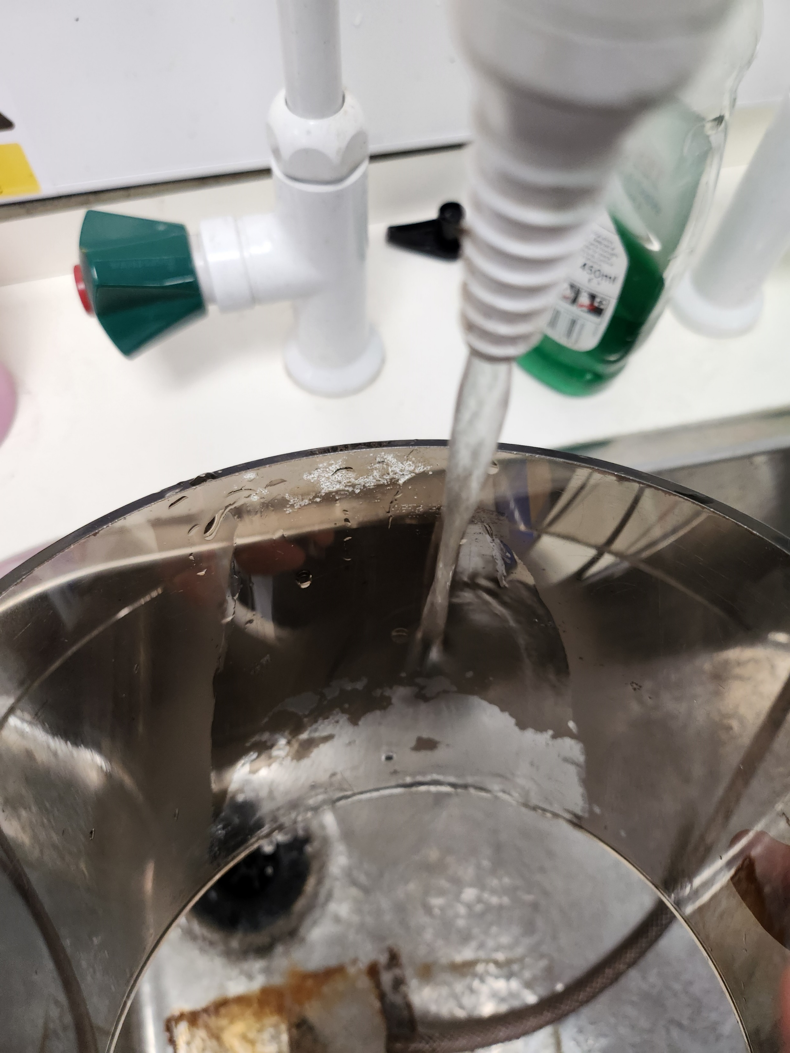
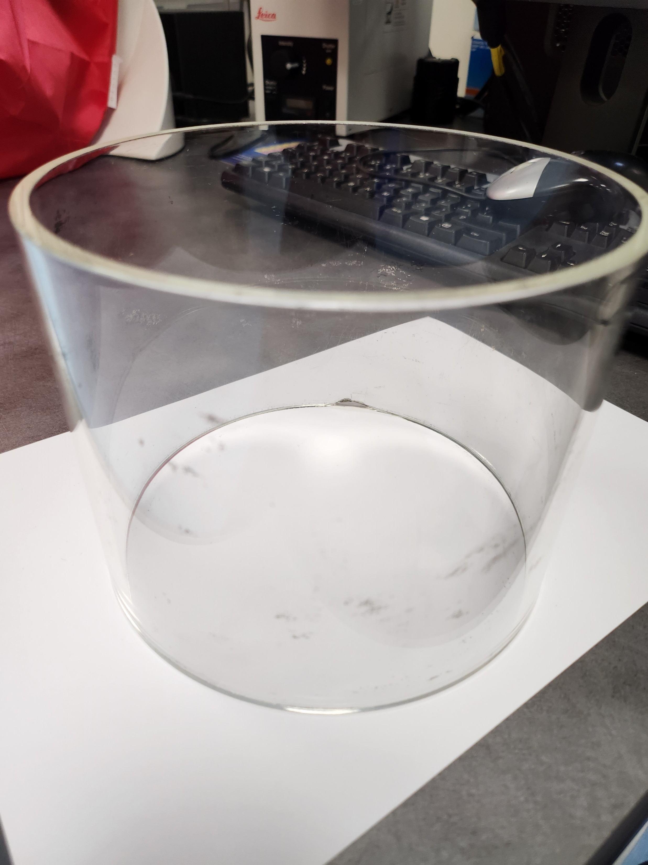
Easy method for cleaning Carbon Coater Glass Jar
You come to use to carbon coater and the previous user has not cleaned it after use – annoying
Ideally you need to have a clear jar so you can see the quality of the spark\coating, so need to clean before use
Tip - If you hold the jar under warm\hot running water, the carbon should just rinse away, without having to rub clean
Leaving a nice clean jar so you can get on with your coating – remember to clean after use though!

