Slide 1




The 21st International Microscopy Congress (IMC21) 2026
31 August - 4 September 2026, LEX Liverpool, UK
Pre-Congress Events 30 August 2026
‘The Next Generation – Embracing the Responsible AI Revolution’
Scan the QR code or visit www.imc21.org.uk for the latest updates and to sign up to our mailing list
IMC21_Liverpool

Slide 2
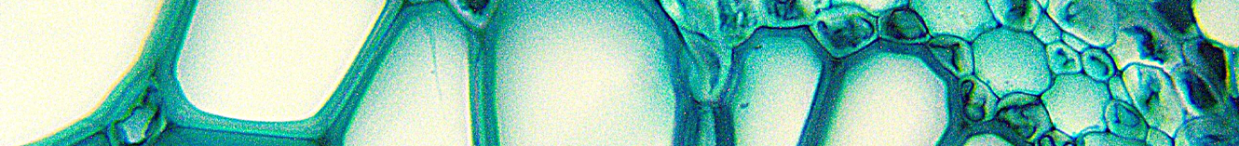
The 21st International Microscopy Congress (IMC21) 2026
31 August - 4 September 2026, LEX Liverpool, UK
Pre-Congress Events 30 August 2026
The 21st International Microscopy Congress (IMC21) is a fantastic way for delegates to inspire and empower the next generation whilst meeting and reuniting with colleagues in the vibrant and cultural city of Liverpool.
The IMC21 Congress theme is The Next Generation – Embracing the Responsible AI Revolution. This overarching congress theme represents a compelling and forward-looking vision and captures the spirit of innovation and evolution.
Scan the QR code or visit www.imc21.org.uk for the latest updates and to sign up to our mailing list
IMC21_Liverpool

Slide 3
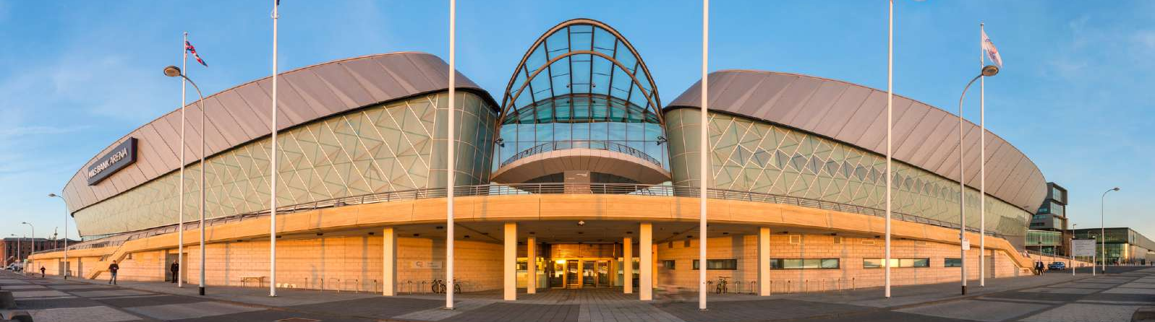
The 21st International Microscopy Congress (IMC21) 2026
31 August - 4 September 2026, LEX Liverpool, UK
Pre-Congress Events 30 August 2026
Located on the banks of the River Mersey in the heart of the city, the award-winning Liverpool Experience Campus is home to a purpose built, interconnected convention centre, arena and exhibition centre.
IMC21_Liverpool
IMC21_Liverpool

